Slide 1
REDESIGN HOSTEL APP – UX CASE STUDY
SHARON STEVE (211701050)
YALLANKI.SUDHEER (211701061)
Mentor: Mr. Gunasekar S
BATCH NO. : B2121M632

Slide 2
PROBLEM STATEMENT
Students face usability challenges with the existing leave request application.
Flawed information architecture leads to prolonged processing times for gate pass applications.
Difficulty in locating applied gate passes within the app adds to user frustration.

Slide 3
ISSUES IDENTIFIED
Usability hurdles impede seamless application for gate passes.
Poor information architecture results in prolonged processing times.
Gate passes are difficult to locate within the application interface.
To identify these issues we followed the Design thinking process.

Slide 4
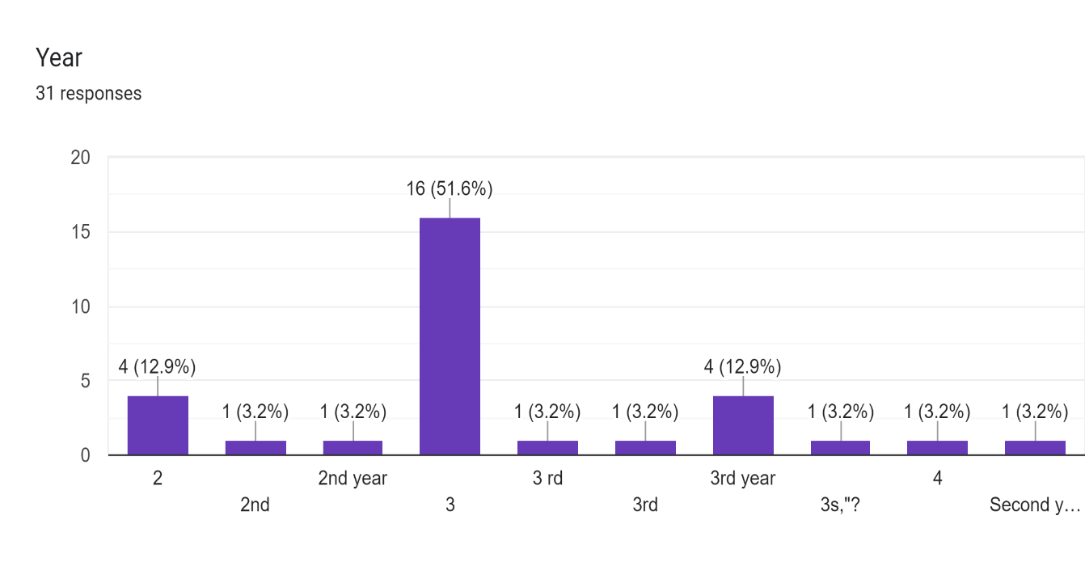
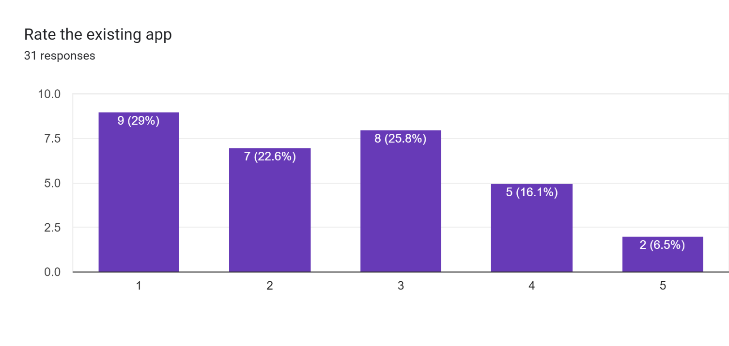
SURVEY RESPONSE
We conducted live survey from the hostel students and the responses were noted.

Slide 5
PATTERN IDENTIFIED
The pattern is identified and is shown below:
It was observed that 15 out of 31 participants Need the app to be more engaging. This means that the information architecture of the app needs a change and the aesthetic of the app need to be improved.
It was observed that 10 out of 31 participants face issues regarding revisiting the already applied gate passes. This means that the applied gate passes should be made easy to visit in the app.
It was observed that 5 out of 31 participants cannot use in iOS devices. This means that the app needs to be optimized for iOS Users too!
It was observed that 5 out of 31 participants leave requests not handed over to warden and faculty half the time and applied requests not visible offline. This means that the app needs to show gate passes offline too.

Slide 6
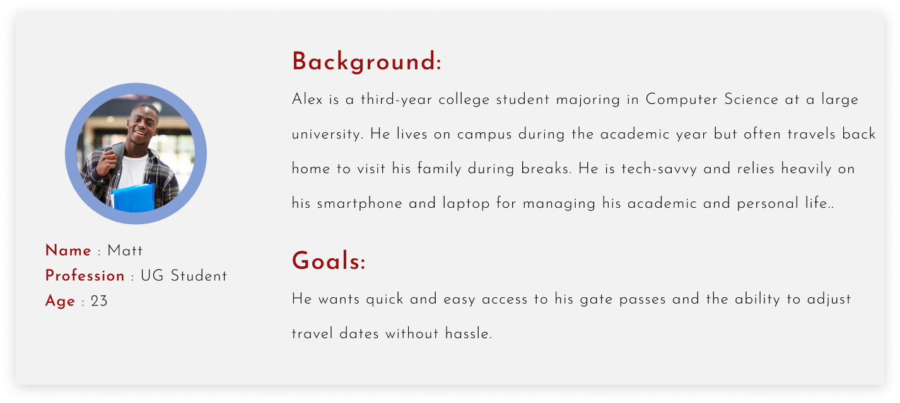
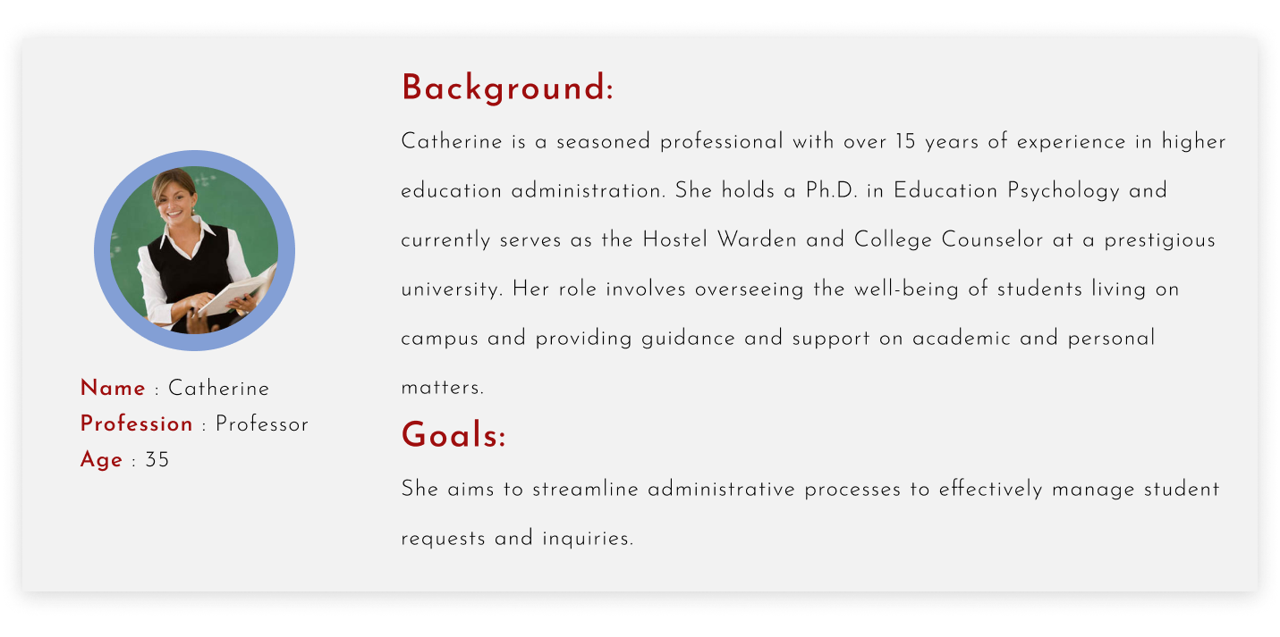
PERSONA
A persona is a fictional character which represents certain traits and qualities of real users.

Slide 7
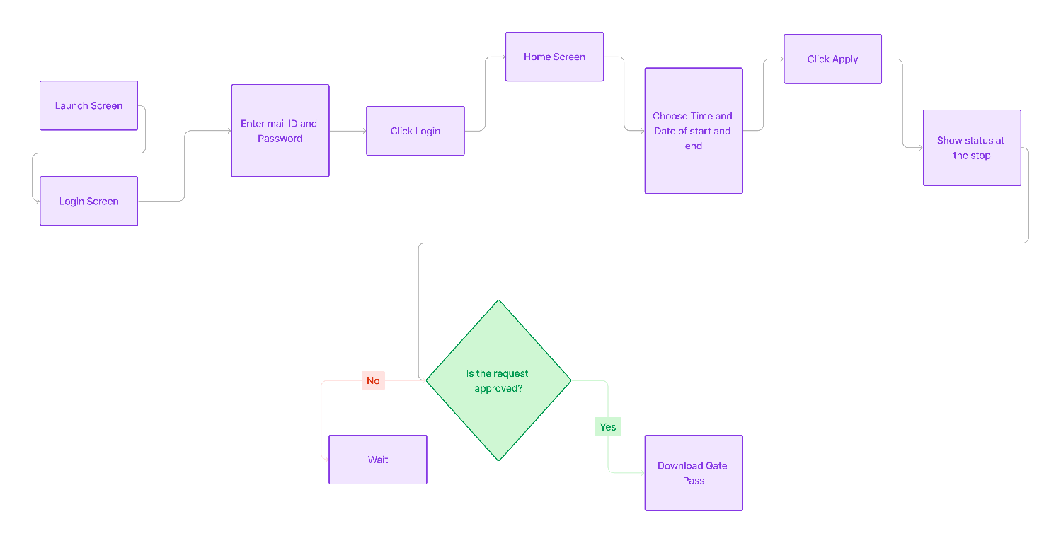
USER FLOW
User flow in UX design encompasses the sequence of steps or actions a user takes to achieve a specific task or goal within a product or service.

Slide 8
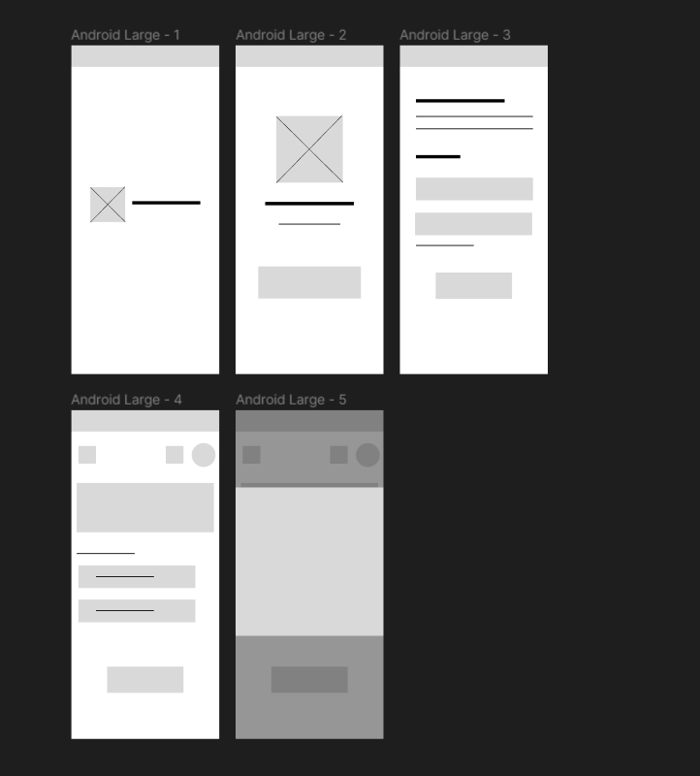
LOW-FI PROTOTYPE
Digital wireframes are skeletal outlines or blueprints of a digital product, such as a website, mobile app, or software interface, created during the early stages of UX design.

Slide 9


USABILITY STUDY - ITERATIONS
Users expressed confusion and frustration when attempting to find the section for viewing already applied gate passes.
To address this issue, it was proposed to add a dedicated section or shortcut on the home screen for users to easily access their already applied gate passes. This would provide users with a more intuitive and efficient way to view important information about their passes.

Slide 10
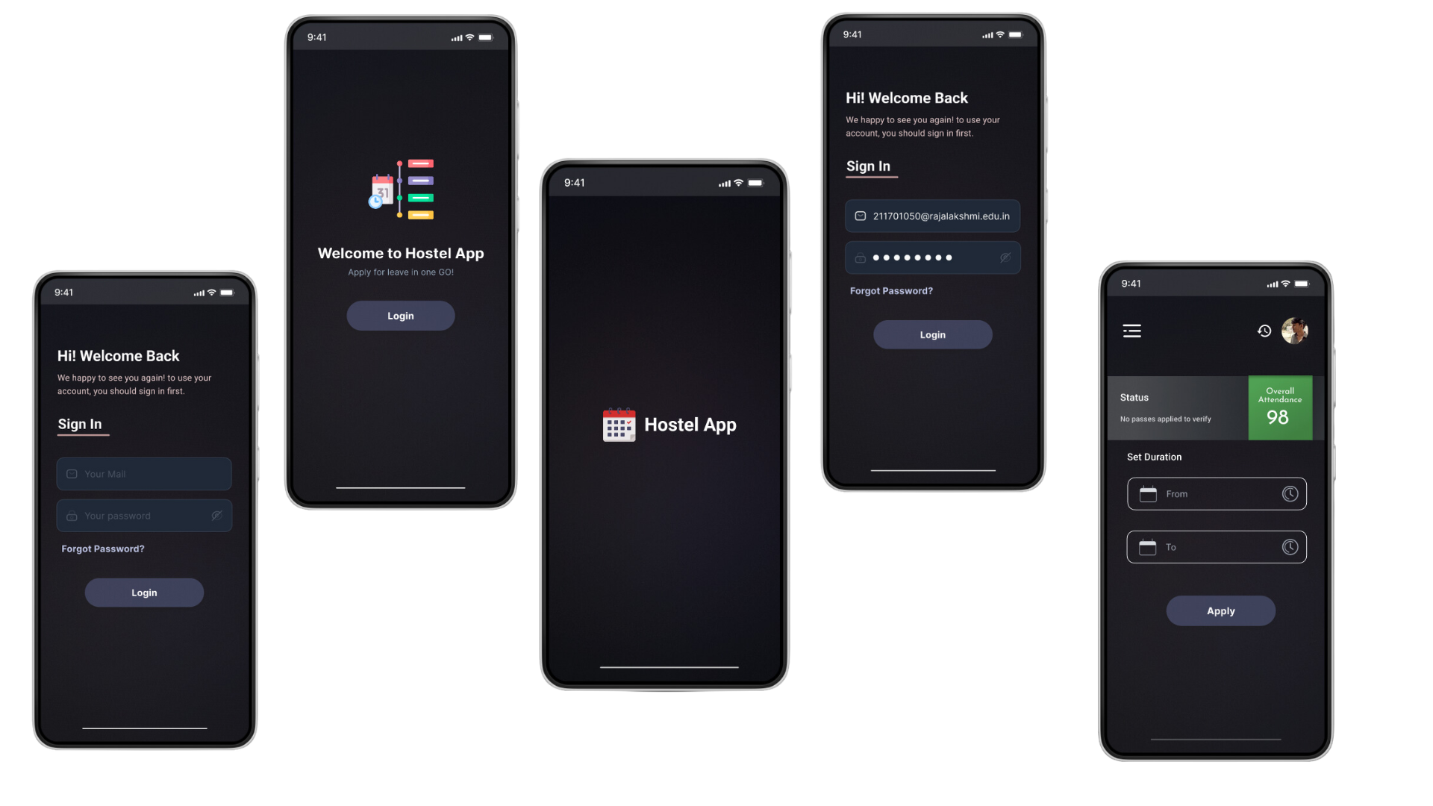
FINAL PROTOTYPE

Slide 11
CONCLUSION
Implementation of a user-centric redesign addresses usability challenges.
New features such as intuitive navigation enhance app accessibility.
Streamlined leave request process reduces processing times and user frustration.
Enhanced gate pass management facilitates easier access and tracking within the app.
Overall, the redesign significantly improves the user experience and efficiency of the leave request application.

